Slide 1
HAEE ENERGY WORKSHOP 2017
Athens, 2 October 2017
“DEPA prepares for the energy challenges
in SE Mediterranean”
Dr. Stelios Bikos, Head of Commercial Division

Slide 2
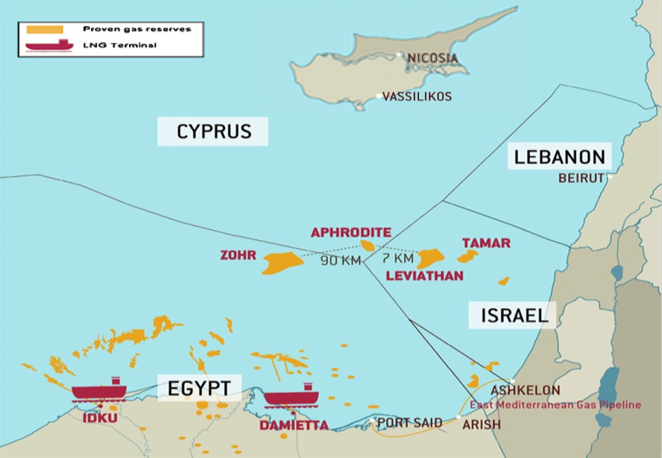
Gas resources in the Eastern Mediterranean

Slide 3
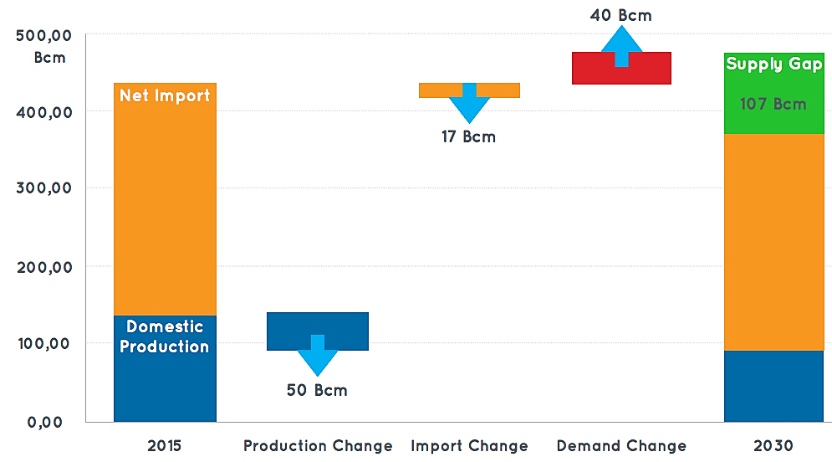


European gas market: needs of additional gas import
Under OME estimation, EU may require up to 100 bcm of new gas supply (non-traditional sources) by 2030 compared to 2015.
EU increased gas import requirements are mainly deriving from:
declining domestic production: caused by the depletion of current gas fields, especially in North Sea (up to approx. 50 bcm less in 2030)
reduced gas imports from traditional suppliers: Norway and Algeria expected to decrease the exports to EU (up to approx. 17 bcm less in 2030)
growing gas demand: expected to increase in the EU by approx. 40 bcm in 2030 (still below pre-crisis levels).

Slide 4
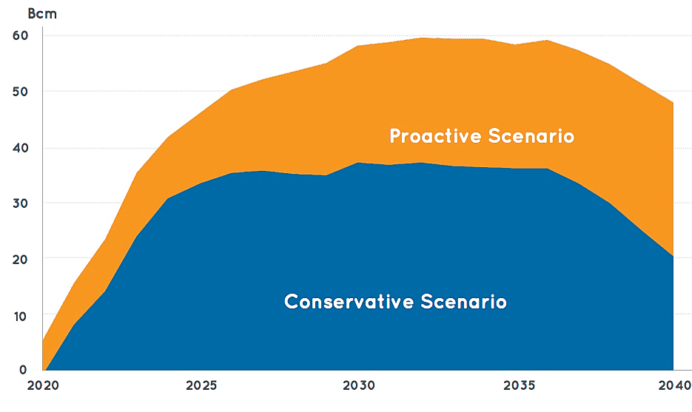

Eastern Mediterranean region: export potential
Eastern Mediterranean gas volumes available for exports
The Eastern Mediterranean region export potential to world gas markets will considerably increase in the next years:
Conservative scenario: 30 bcm/y
Proactive scenario: 50 bcm/y
Conservative Scenario: takes into account past trends, current policies and measures.
Proactive Scenario: emphasizes energy security and environmental concerns.

Slide 5
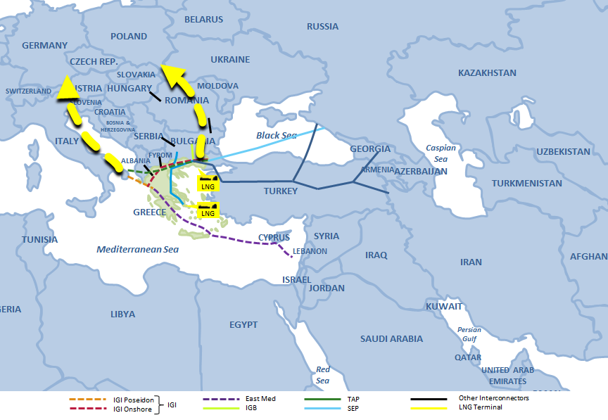
Greece – The Gateway to Europe A panoramic view of the area
LNG
LNG
IGI Poseidon IGI Onshore
IGI
East Med
TAP
SEP
Other Interconnectors
LNG Terminal
Planned LNG (FSRU)
IGB

Slide 6

Greece – The Gateway to Europe
Key projects will enhance national and regional energy security
and may catalyse a gas trading hub in Greece
Unlike purely geopolitically driven pipeline plans, those proposed here are realistically based on business merit
DEPA contribution:
Slovenia
Hungary
Romania
Russia
Southern Gas Corridor / TAP
SGC underpins regional Market development and integration
DEPA is a significant stakeholder of the Southern Corridor as a buyer of SD2 gas and as a sponsor of IGB
The timely realization of TAP will enhance the connection of SEE with mature Central European markets
IGB
Will connect Bulgaria with LNG and gas from the Caspian and the Middle East through existing and new pipelines (i.e. TAP) and the Greek existing (Revythousa) and planned (Alexandroupolis) LNG terminals
It is included in the 2nd PCI list and CESEC list and it is an integral part of the Vertical Corridor contributing to the security of supply of regions of poor diversification
FID taken on 10 December 2015
Ongoing new Market Test with the objective to attract the highest possible capacity bookings
Croatia
B&H
Serbia
Italy
Montenegro
Kosovo
Bulgaria
Albania
FYROM
LNG
Greece
Turkey
LNG
Egypt
TAP
SEP
East Med
IGI Poseidon IGI Onshore
IGB
Other Interconnectors
LNG Terminal
IGI

Slide 7
Greece – The Gateway to Europe
LNG Terminal in Northern Greece (Alexandroupolis)
Will ease global LNG supplies into the SEE region through its proximity to the IGB
It is included in the 2nd PCI list
Developed together with international partners/investors
IGI Poseidon
A mature project, ready to take FID as soon as gas resources are secured
May transport natural gas from Russia or alternatively from Iran, East Mediterranean, Middle East and/or Caspian areas (Kurdistan, Turkmenistan) to Italy and Europe
It is included in the 2nd PCI list
Slovenia
Hungary
Romania
Russia
Croatia
B&H
Serbia
Italy
Montenegro
Kosovo
Bulgaria
Albania
FYROM
LNG
Greece
Turkey
LNG
Egypt
TAP
SEP
East Med
IGI Poseidon IGI Onshore
IGB
Other Interconnectors
LNG Terminal
IGI

Slide 8
Greece – The Gateway to Europe
South European Pipeline
A practical option that may benefit from existing work in the IGI onshore & offshore pipeline projects
Existing supply contracts into Italy could be easily diverted to SEP and enhance the project viability
EastMed
European market constitutes a lucrative monetization option for the Eastern Mediterranean gas since it is a premium market with potential supply gap
The latest developments in the region with the discovery of the Zohr gas field triggered reevaluation of monetization options
The opening of a new Energy Corridor (EastMed) is fundamental for Europe’s energy security providing source, route and supplier diversification
It is included in the 2nd PCI list
Slovenia
Hungary
Romania
Russia
Croatia
B&H
Serbia
Italy
Montenegro
Kosovo
Bulgaria
Albania
FYROM
LNG
Greece
Turkey
LNG
Egypt
TAP
SEP
East Med
IGI Poseidon IGI Onshore
IGB
Other Interconnectors
LNG Terminal
IGI

Slide 9
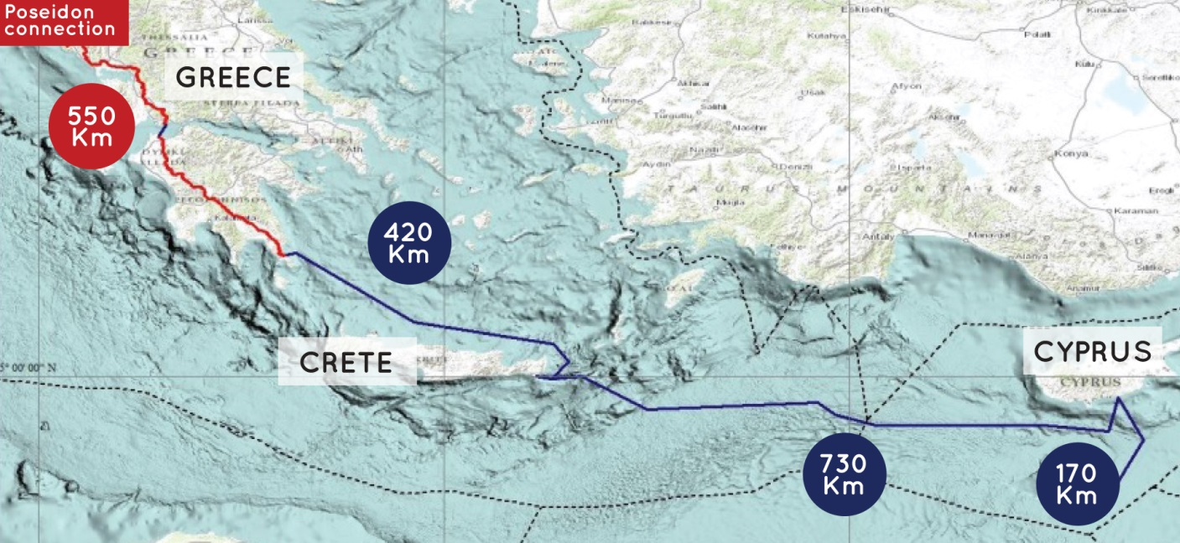
EastMed Pipeline: Project description
The East-Med Pipeline is an offshore/onshore pipeline, approximately 1900 km long, directly connecting East Mediterranean gas reserves to Greece, via Cyprus and Crete. The Project is currently designed to transport initially 10 Bcm/y from the Levantine Basin gas fields into Greece and, in conjunction with the Poseidon Pipeline, into Italy.
During the period 2015-2016, IGI Poseidon has finalized, also thanks to EU financial contribution under the CEF program, with the support of first class international engineering (Intecsea and C&M consortium) and global consultancy (IHS-Cera) firms, the PRE-FEED studies, definitively confirming that the EastMed Pipeline Project is:
technically feasible economically viable commercially competitive

Slide 10
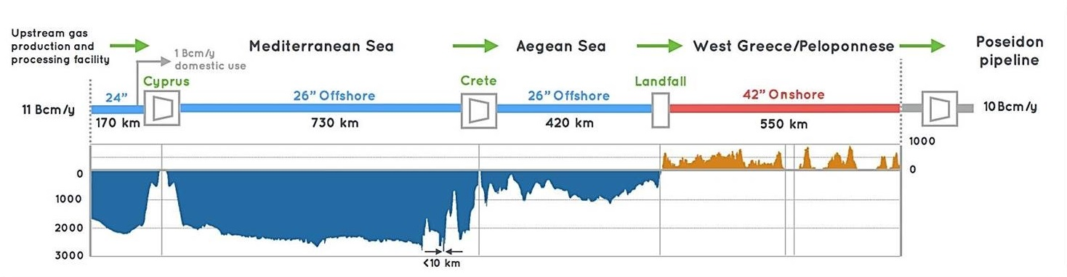
EastMed Pipeline: Technically feasible
The technical results of the Pre-FEED studies performed by the consortium IntecSea – C&M Engineering, clearly indicate that EastMed project is technically feasible:
Manufacturability confirmed by leading mills in Europe, India and Japan
Constructability confirmed by pipelay contractor using the current pipelay fleet
IntecSea and C&M Engineering have estimated the overall investment cost of the EastMed project in 5.2B€.
Fits with European Union doctrine in regards to optimization and commissioning of new projects diversify gas sources, route and end market

Slide 11
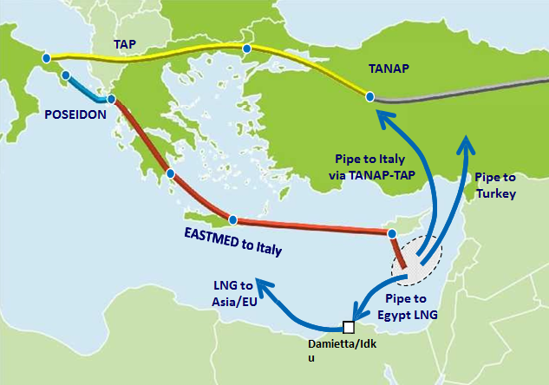
Eastern Mediterranean region: export options
Current reserves of the Eastern Mediterranean region, without accounting future discoveries in a widely underexplored region, could support multiple and complementary export schemes.
3 main destination markets are currently under consideration :
Turkey, large and fast growing market with the demand expected to rise by approx. 25 bcm in 2040
Europe, by far the largest energy importer in the world with the ambition to diversify its supply sources
Global LNG, well supplied market conditioned by the significant increase of global liquefaction capacity (+40% by 2020)
Several export options under assessment:
pipe to Turkish market
existing Egypt LNG facilities to Asian market
existing Egypt LNG facilities to European market
pipe to European market, using TANAP /TAP chain
EastMed pipeline to European market
new liquefaction plant in Cyprus

Slide 12

Economic Assessment of Supply Options for East Med gas
The global information company IHS-CERA considering the ytd exportable surplus of Israel plus Cypriot gas, which exceeds 30 bcm/y, advised that multiple export options should be pursued in parallel to facilitate gas export.
IHS highlights economical viability of the EastMed among other export options in the region:
complementary to other export options considered not mutually exclusive: No “must-do” option has been identified
slightly more attractive from an economical point of view of other export options to EU
offering from a qualitative point of view more value for money :avoiding geo-political constrains via a fully European undisputed route and ensuring access to European liquid market avoiding transit risks.

Slide 13
National Energy Policy
Gateway to Europe and beyond (TAP, SEEC, EastMed).
Destination country through the development of the internal and regional markets.
As a combination of the above two, Greece, and particularly Alexandroupoli area, to become an efficient HUB for the region.
Focus on potential indigenous production of hydrocarbons and further development of renewables.
Creation of a national energy stock market.
Optimal use of the offshore physical gas storage area near Kavala.
The development of strategic and financially viable projects in the energy sector, in hand with an efficient national energy diplomacy, may significantly contribute to the country’s forthcoming economic recovery and rate of growth.

Slide 14
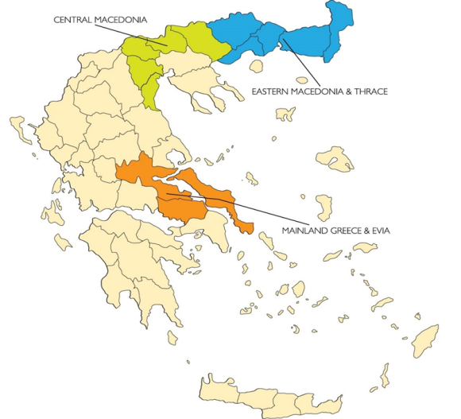
DEPA’s Group Investment and Development Priorities:
To create a certain “GAS CULTURE CONCEPT” for the Greek society, aiming to double the number of gas meters from current 355,000 to +700,000 by 2026.
To develop CNG / LNG technology in remote areas incl. islands and individual remote consumers.
To ensure supply of natural gas in 16 regional capitals and other towns and industrial areas by 2021.
To lengthen the 450 km existing distribution network by nearly 1.200 additional Kms.
To create more than 1.700 jobs during the construction of the network and at least 800 new permanent jobs while the operation.
To improve the National Environmental footprint.
To reduce energy poverty and exclusion.
To strengthen the presence of gas in the retail market energy.
To promote LNG as a ship fuel (LNG bunkering etc.).
To promote CNG as onshore transport fuel (FISIKON brand name).

Slide 15
Thank you for your attention

