Slide 1

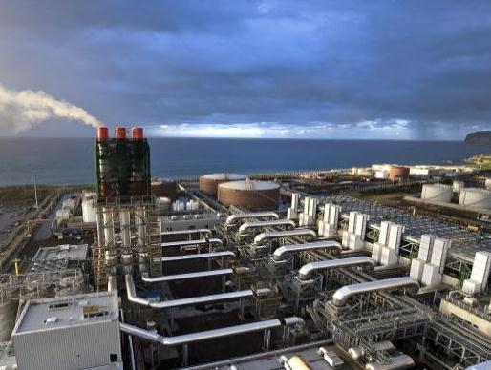
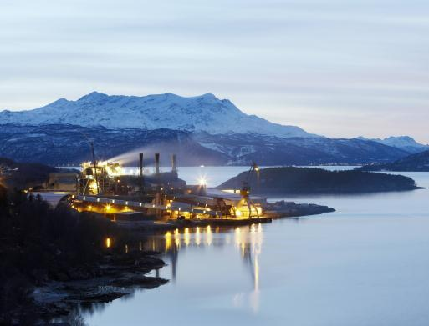
MAN Diesel & Turbo
„Engineering the Future – since 1758.“
Dionissis Christodoulopoulos
Managing Director,
MAN Diesel & Turbo Hellas Ltd

Slide 2
Content overview
1
MAN at a glance
2
Engines & Marine Systems – Products & Applications
3
Power Plants – Products & Applications
4
Turbomachinery – Products & Applications
5
MAN Cryo – Products & Applications
6
Global Megatrends

Slide 3

Volkswagen Group 12 brands

Slide 4

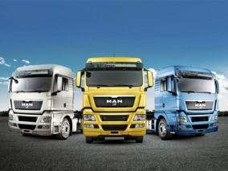
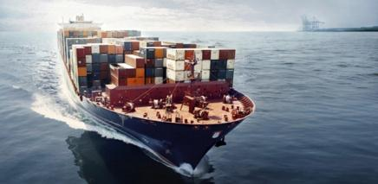

MAN at a glance
MAN SE
Commercial Vehicles
Power Engineering
Business areas
Divisions
MAN
Truck & Bus
MAN
Latin America
MAN
Diesel & Turbo
Renk
(76 %)
Investments
Sinotruk (25.0 % +1 share), Scania (17.4 %*)
* Voting rights
The MAN Group in 2016: €13.6 billion revenue, 53,824 employees

Slide 5
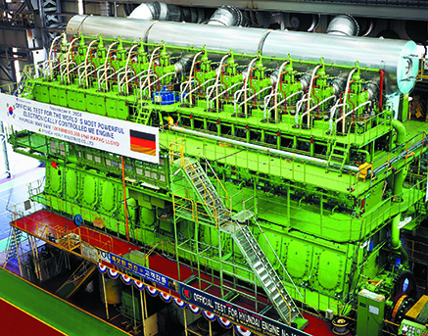
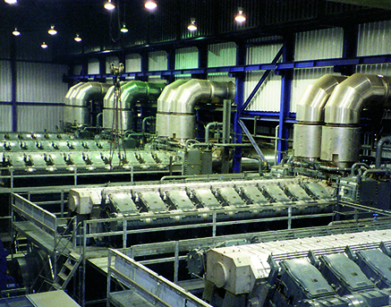
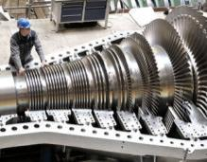
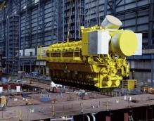
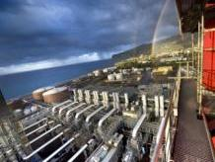
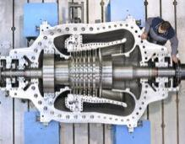

MAN Diesel & Turbo A worldclass product portfolio
Engines & Marine Systems
Power Plants
Turbomachinery
Two-stroke and four-stroke engines for marine applications
Propellers and complete propulsion systems incl. fuel gas systems
Turbochargers
Two-stroke and four-stroke engines for stationary applications
Diesel and gas power plants
Compressors, gas and steam turbines, expanders
Complex machinery trains
Chemical reactors
Service: MAN PrimeServ
Worldwide network of service hubs:
24/7 OEM service around the globe

Slide 6
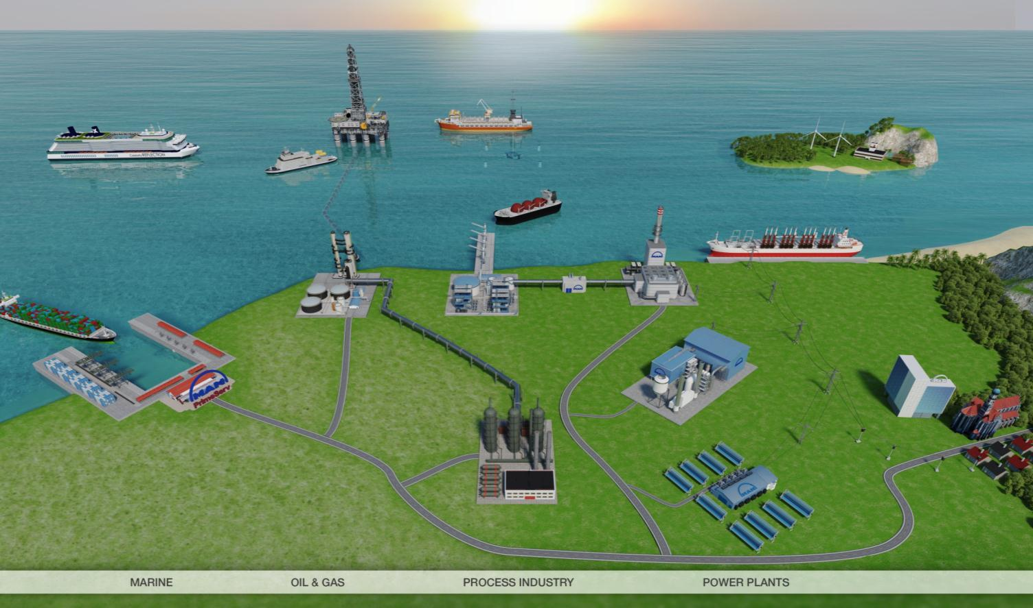
MAN Diesel & Turbo Comprehensive applications in diverse industry areas

Slide 7
Content overview
1
MAN at a glance
2
Engines & Marine Systems – Products & Applications
3
Power Plants – Products & Applications
4
Turbomachinery – Products & Applications
5
MAN Cryo – Products & Applications
6
Global Megatrends

Slide 8
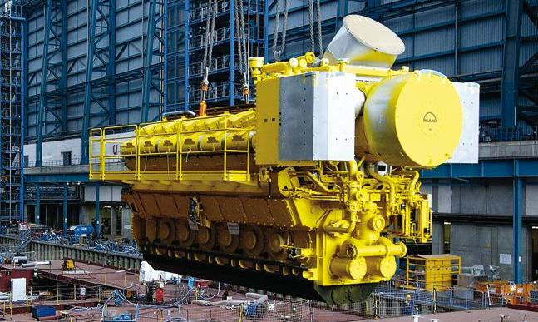
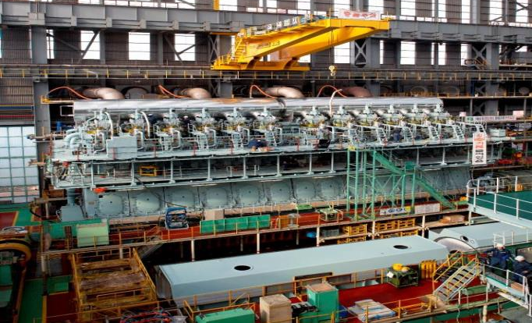
Engines & Marine Systems Comprehensive product portfolio for marine applications
Two-stroke and four-stroke engines for marine applications
Output range from 450 kW to 82.4 MW
Marine GenSets from 450 kW to 11.2 MW
Fuels: heavy fuel oil, diesel, gas, dual fuel
Propellers and complete marine propulsion systems incl. fuel gas systems (MAN Cryo)
Axial and radial turbochargers for two-stroke and four-stroke engines, injection systems, systems electronics
Notes:
8

Slide 9
Content overview
1
MAN at a glance
2
Engines & Marine Systems – Products & Applications
3
Power Plants – Products & Applications
4
Turbomachinery – Products & Applications
5
MAN Cryo – Products & Applications
6
Global Megatrends

Slide 10
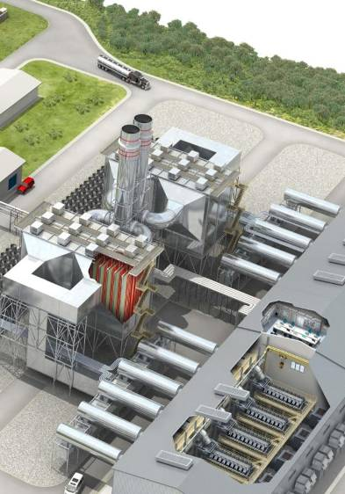
Power Plants Broad portfolio for engine-based diesel and gas power plants
Two-stroke and four-stroke engines from 1,100 kW to 77.500 kW
Diesel and gas power plants up to 300 MW
Combined heat and power plants, motor combined cycle
Excellent fuel flexibility: diesel, heavy fuel oil, biofuels, gas, dual fuel
Operation and maintenance, complete services
Expandable, modular concepts
Notes:
10

Slide 11
Content overview
1
MAN at a glance
2
Engines & Marine Systems – Products & Applications
3
Power Plants – Products & Applications
4
Turbomachinery – Products & Applications
5
MAN Cryo – Products & Applications
6
Global Megatrends

Slide 12
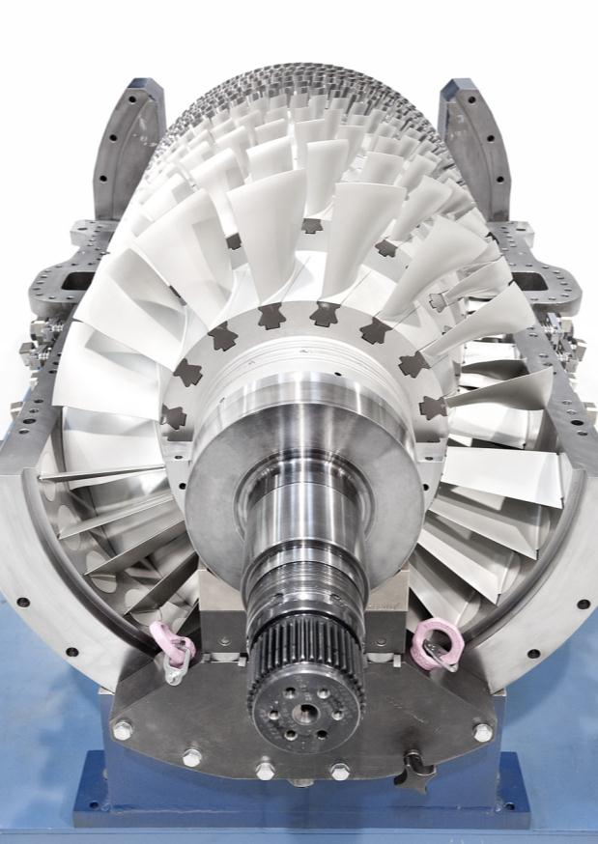
Turbomachinery Wide-ranging product range for various industrial applications
Compressors, expanders, gas turbines and steam turbines for the oil & gas industry, the process industry and power generation
Full machinery train competence including compressor, drive and expander
Reactors for the chemical and petrochemical industry, special apparatus for science
Notes:
12

Slide 13
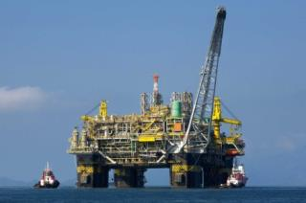
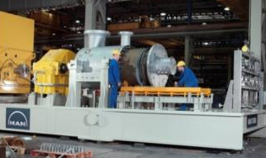
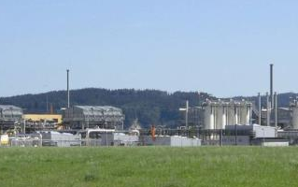
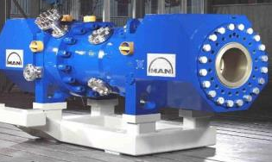
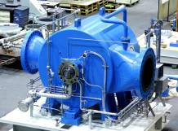

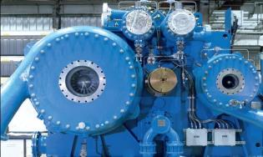
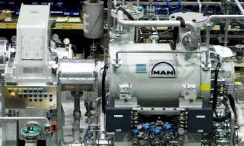
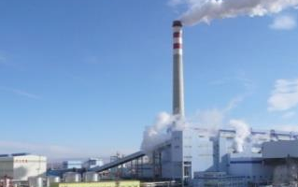
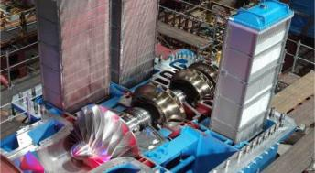
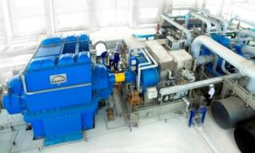
Turbomachinery Applications From the oil & gas market to process industry
Gas Processing
Gas Gathering
Gas Lift / Reinjection
Gas Export / Treatment
Subsea Compression
CO2 Injection
LNG
Propane / Butane / Ethane
UPSTREAM
Gas Transport
Gas Storage
Boil-off Gas
MIDSTREAM
Refineries:
H₂ Production
GTL-SynGas / Reaktors
Coal / Oil Gasification
Dealyed Coking
Petrochemicals:
Chlorines
Methanol
Vapor Recompression
DOWNSTREAM
Air Separation
Air Storage (CAES)
Blast Furnace
Paper - Turbair™
Mine Ventilation
Food Industry
Wind Tunnel
INDUSTRIAL GASES

Slide 14
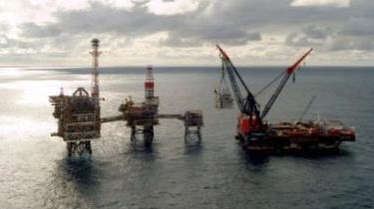
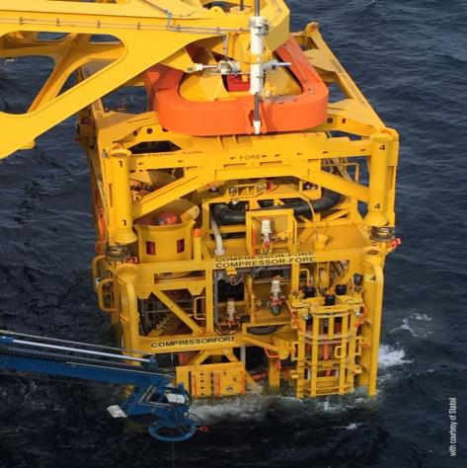
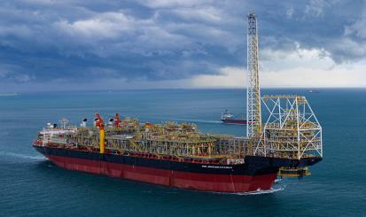
Contract List Offshore
More than 180 casing on platforms sold since 1977
World’s first Subsea Compressor Unit,
Åsgard Subsea Compression Project,
in operation since September 2015.
More than 60 casing on FPSOs sold since 1994

Slide 15

Subsea Compression
Increased recovery
Reduced CAPEX and OPEX
Reduced carbon footprint
HSE benefits

Slide 16



Åsgard Subsea Compression Project
MAN Diesel & Turbo:
the first and only successful manufacturer
of subsea compressors
Water depth 300 m
Gas pressure 220 bar
Power rating 2x 11 MW
Notes:
16
Water depth: 260 m
Flow rate: 21 MSm3/d
Differential pressure: 60 bar
Shut in pressure: 220 bar
Tie-back distance: 40km
Size: 75m x 44m x 24m

Slide 17


Successful
Åsgard Subsea Compression
First of its kind in the industry: Subsea HOFIM™
one and a half year of uninterrupted operation of the world's 1st subsea gas compression station
Motor-compressor related availability: 100%
Notes:
Asgard compression:
Project from Statoil
EPC: Aker Solution
Commissioning:
Cold Commissioning (control system test) executed in parallel with first time installation of the modules. Completed 1 week after the last module was installed.
Hot Commissioning (pump running on MEG and compressor on N₂) executed in 10 days, all according to the procedures.
Excellent cooperation between the onshore and offshore commissioning teams, first compression train was in normal operation only 4 weeks later
No major findings - some expected fine-tuning of the control system
Operation
No unexpected shut-downs
Extreme slugging conditions during start-up
Exceeding increased production targets on both gas and condensate
Start-up after plant shut-down performed as expected
Operates like a swiss watch

Slide 18
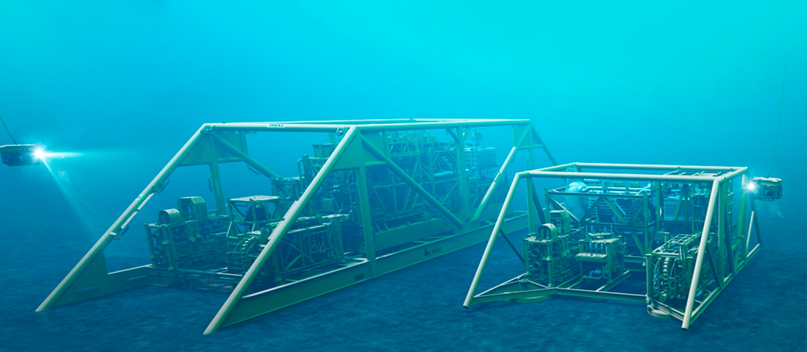
World Leading Technology, Now Even Smaller
Today
75 meters long
2,500 tonnes
Tomorrow
Less than half the size and weight

Slide 19
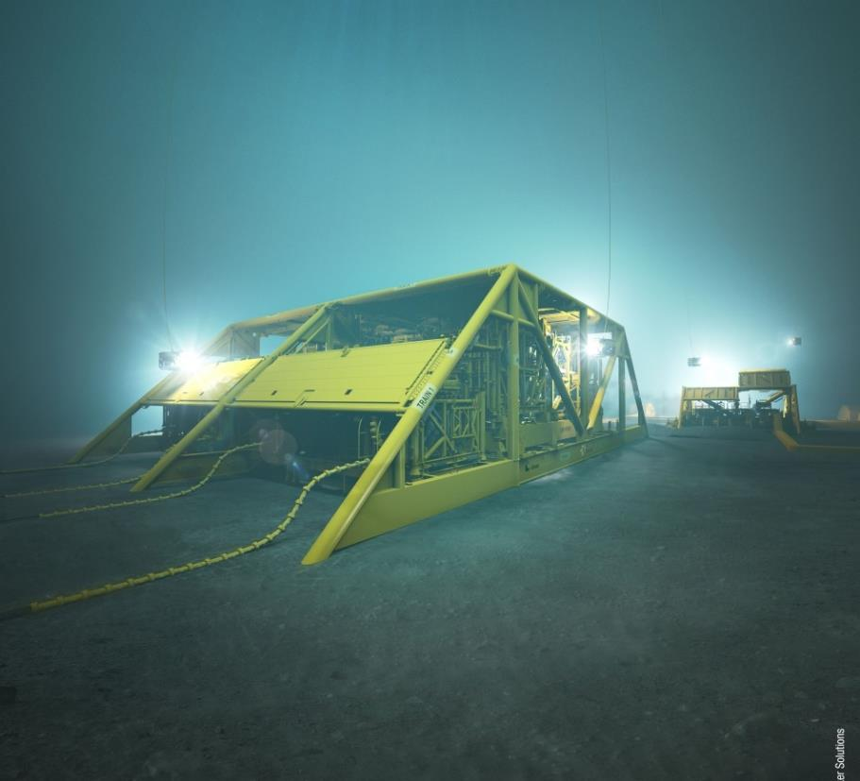
Summary – Subsea Compression
… it just works and we know what it takes
Successful operation on Åsgard
Subsea Compression Alliance
Significant cost, size and weight savings
We are ready for the next challenge
→ Well stream compression system development

Slide 20
Content overview
1
MAN at a glance
2
Engines & Marine Systems – Products & Applications
3
Power Plants – Products & Applications
4
Turbomachinery – Products & Applications
5
MAN Cryo – Products & Applications
6
Global Megatrends

Slide 21
MAN Cryo A versatile supplier of LNG Fuel Systems
Advanced cryogenic technology for storage, transportation and handling of liquefied gases
EPC services for both onshore and offshore applications

Slide 22
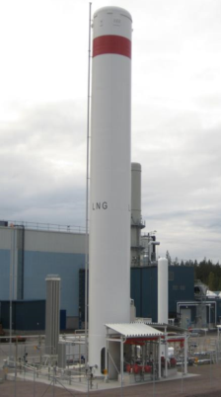
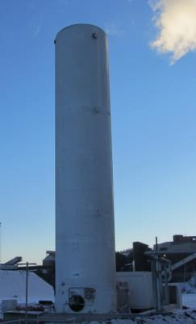
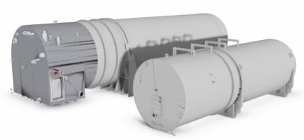
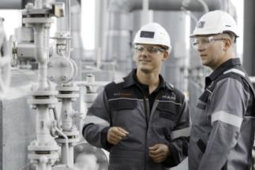
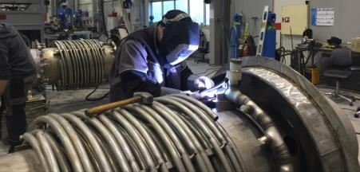
MAN Cryo A versatile supplier of LNG Fuel Systems
LNG Marine Systems
LNG Power Plant Systems
Turbomachinery LNG Technology
LNG Fuel Systems for two-stroke and four-stroke engines.
LNG Fuel Systems for stationary applications.
Diesel and gas power plants.
Backup systems
Liquid Air Cryogenic Energy storage
Service: MAN PrimeServ
Worldwide network of service hubs:
24/7 OEM service around the globe
Workshop with specialists in Gothenburg

Slide 23
Content overview
1
MAN at a glance
2
Engines & Marine Systems – Products & Applications
3
Power Plants – Products & Applications
4
Turbomachinery – Products & Applications
5
MAN Cryo – Products & Applications
6
Global Megatrends and Outlook for EastMEd

Slide 24




Global megatrends Drivers of our business
Worldwide seaborne trade will double until 2030
Growing demand of energy efficient ships and propulsion solutions
Increase of world trade and international passenger traffic
TRANSPORT
Global energy demand will almost double until 2030
Growing importance of decentralized energy generation
Increase of energy demand
ENERGY
Increasing demand of industrial products
Worldwide consumption will nearly double until 2025 with another 1.8 billion people entering the global consuming class
INDUSTRY
Introduction of emission standards
Growing significance of gas as fuel
Climate change
CLIMATE
Notes:
Global megatrends and developments drive our business: in worldwide transport, in energy generation, in industrial production.
Climate and environmental requirements drive our technology development.
Sources:
Transport: Lloyd's Register (2013): Global Marine Trends 2030
Energy: International Energy Agency (2013): World Energy Outlook 2013
Industry: McKinsey (2012). Manufacturing the future: The next era of global growth and innovatoin

Slide 25
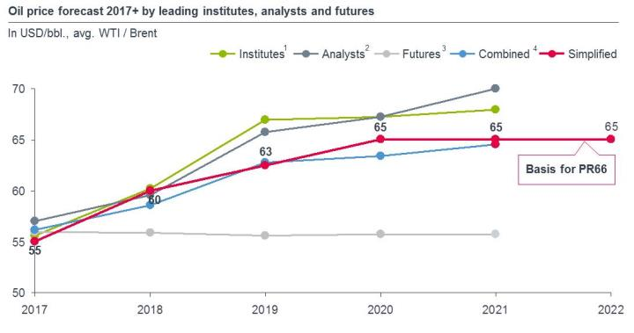
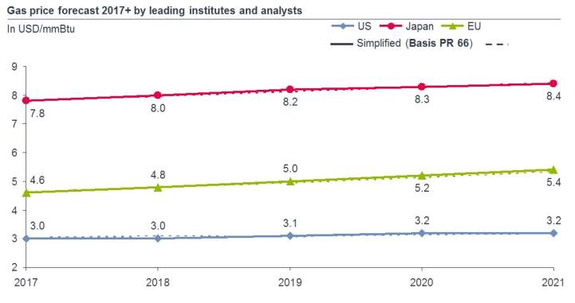
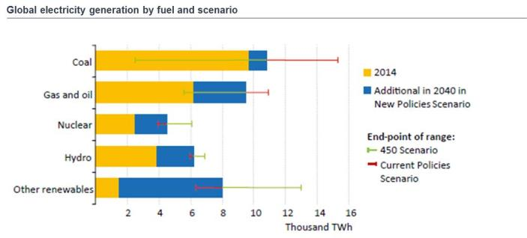
Global megatrends Drivers of our business
Oil price for the next years is supposed to be in the range of $55 to $70 per barrel as a ‘new normal’, no recovery foreseeable to former levels of $100 plus
Decreasing break-evens at shale production expected to continue putting virtual cap on oil price for medium-term future (despite OPEC cuts)
Gas price seemingly stable with slow increase
Global electricity generation expected to increase substantially with largest additions in Renewables and Natural Gas
Global annual economic growth projections of OECD stable for 2016 to 2022 (+3.5%)

Slide 26














Global Megatrends
Maturity of Supply Chain, an example
STS
LNG supply ships (Refrigerated)
LNG-Fueled vessels
Export terminal
Only 5 vessels exist
$30mil/vessel
Refinery
STS
LPG supply ships (Pressurized)
Around 1,000 vessels
$10mil/vessel
LPG-Fueled vessels
Export terminal
STS
Floating vessels
-
❶❷❸❹
20.09.2017 < 52 >

Slide 27
Future
Shell CEO Ben van Beurden believes oil prices will remain "lower forever" as the major focuses more on renewables.
First cost + emission will be the future driver - fuel cost less important
-
❶❷❸❹

Slide 28
MAN Dielsel & Turbo Hellas Outlook for Oil and Gas in East Mediterranen
The East Mediterranean has always been characterized by instability. Now, thanks to energy, it could become a new focal point of development and unexpected opportunities.
Revolutionary technologies used to explore and produce oil and gas lying under deep Mediterranean waters – these have led to the discovery of hydrocarbons in volumes that, once commercially available, will reshape the energy map of the Middle East and Europe.
The regulatory and tax frameworks are still being debated and negotiated and therefore their final design is still uncertain.
In order for the Eastern Mediterranean gas discoveries to become commercially feasible, the international price of oil will probably need to return to the levels that made exploration an attractive proposition in the first place, about $70-80 per barrel.
However the strategic location of these gas discoveries, close to the European market, are so important that their positive impact will likely outweigh the impact of prices that are too low or regulations that are overly onerous.
Notes:
Global megatrends and developments drive our business: in worldwide transport, in energy generation, in industrial production.
Climate and environmental requirements drive our technology development.
Sources:
Transport: Lloyd's Register (2013): Global Marine Trends 2030
Energy: International Energy Agency (2013): World Energy Outlook 2013
Industry: McKinsey (2012). Manufacturing the future: The next era of global growth and innovatoin

Slide 29

Do you have any more questions?

Slide 30
Disclaimer

Slide 31
Thank You For Your Attention
Dionissis Christodoulopoulos
Managing Director
MAN Diesel & Turbo Hellas Ltd.
89, Akti Miaouli
185 38 Piraeus
Greece
Phone : +30 210 45 87 900
Fax : +30 210 4587928-9
E-Mail : dionissis.christodoulopoulos@man.eu

