Slide 1



«Ο ρόλος της Ελλάδας & Κύπρου
στη ΝΑ Μεσόγειο: Γεωπολιτικές
και Ενεργειακές Προκλήσεις»
Φοίβος Συμεωνίδης
Διευθυντής Γεωτρήσεων & Παραγωγής
Αθήνα, 2 Οκτωβρίου 2017

Slide 2
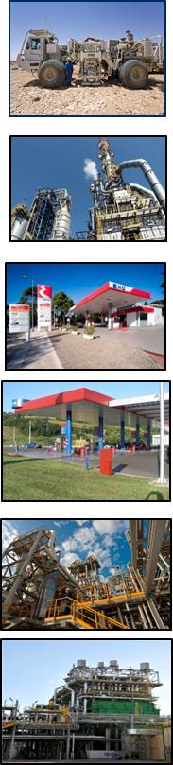
Assets overview
Core business around downstream assets with activities across the energy value chain
DESCRIPTION | METRICS
Exploration assets in Greece | 50% (operator) in W. Patraikos Exploration rights in 4 more areas
Complex (recently upgraded) refining system: Aspropyrgos (FCC, 148kbpd) Elefsina (HDC, 100kbpd) Thessaloniki (HS, 93kbpd) Pipeline fed refinery/terminal in FYROM | Capacity: 16MT NCI: 9.6 Market share: 65% Tankage: 7m M³
Basel technology PP production (integrated with refining) and trading > 60% exports in the Med basin | Capacity (PP): 220 kt
Leading position in all market channels (Retail, Commercial, Aviation, Bunkering) through EKO and HF (BP branded network) | c.1,740 petrol stations >30% market share Sales volumes: 3.5MT
Strong position in Cyprus, Montenegro, Serbia, Bulgaria, FYROM Advantage on supply chain/vertical integration | c.300 petrol stations Sales volumes: 1.1MT
ELPEDISON: Second largest IPP in Greece (JV with Edison/EdF) | Capacity: 810 MW (CCGT)
DEPA/DESFA GROUP: 35% in Greece’s incumbent NatGas supply company (DESFA in sale process) | Volumes (2016): 4.0bcm
Exploration &
Production
Refining, Supply
& Trading
Petrochemicals
Domestic
Marketing
International
Marketing
Power & Gas

Slide 3
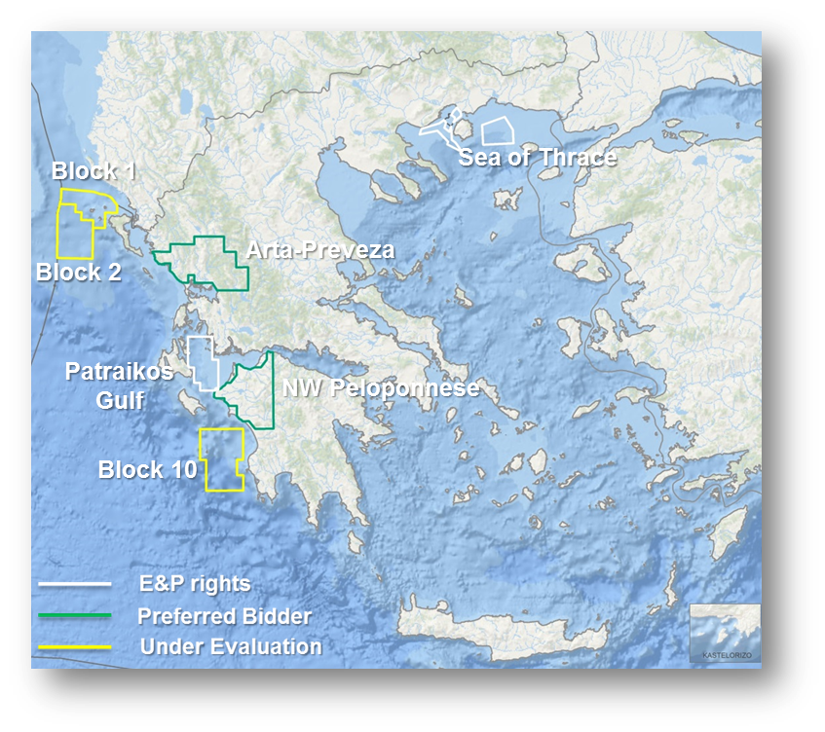
Exploration & Production
Exploration activity focused on Greece
  Patraikos Gulf (offshore)
  Hellenic Petroleum W. Patraikos 50% (operator)
  Edison International S.p.A 50%.
  Final seismic data under review; assessing potential drilling targets (one contractually mandatory in 2018-20)
  Sea of Thrace Concession (offshore)
  Hellenic Petroleum 25%,
  Calfrac Well Services 75%.
  Prospective area surrounding the Prinos oilfield and Kavala gas field
  NW Peloponnese and Arta-Preveza Blocks (onshore)
  Declared by the Ministry of Environment and Energy as “Preferred Bidder”; Lease Agreement signed, ratification expected by Ministry of Energy
  Block 2 offshore W. Greece
  Total 50% (operator), Hellenic Petroleum 25% and Edison International 25% awarded block, Lease agreement initialed, expecting signing
  Block 1 and Block 10 offshore W. Greece
  Hellenic Petroleum has submitted bids for Block 1 and Block 10. Awarded rights for block 10

Slide 4
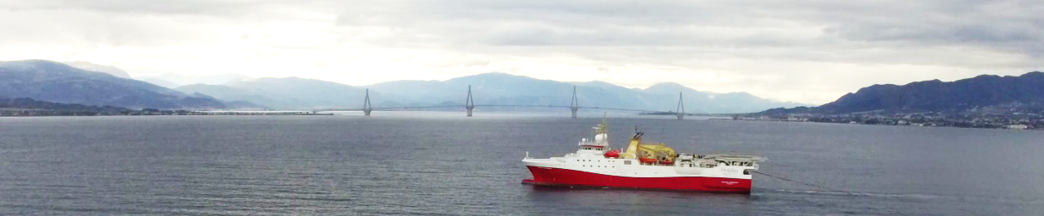
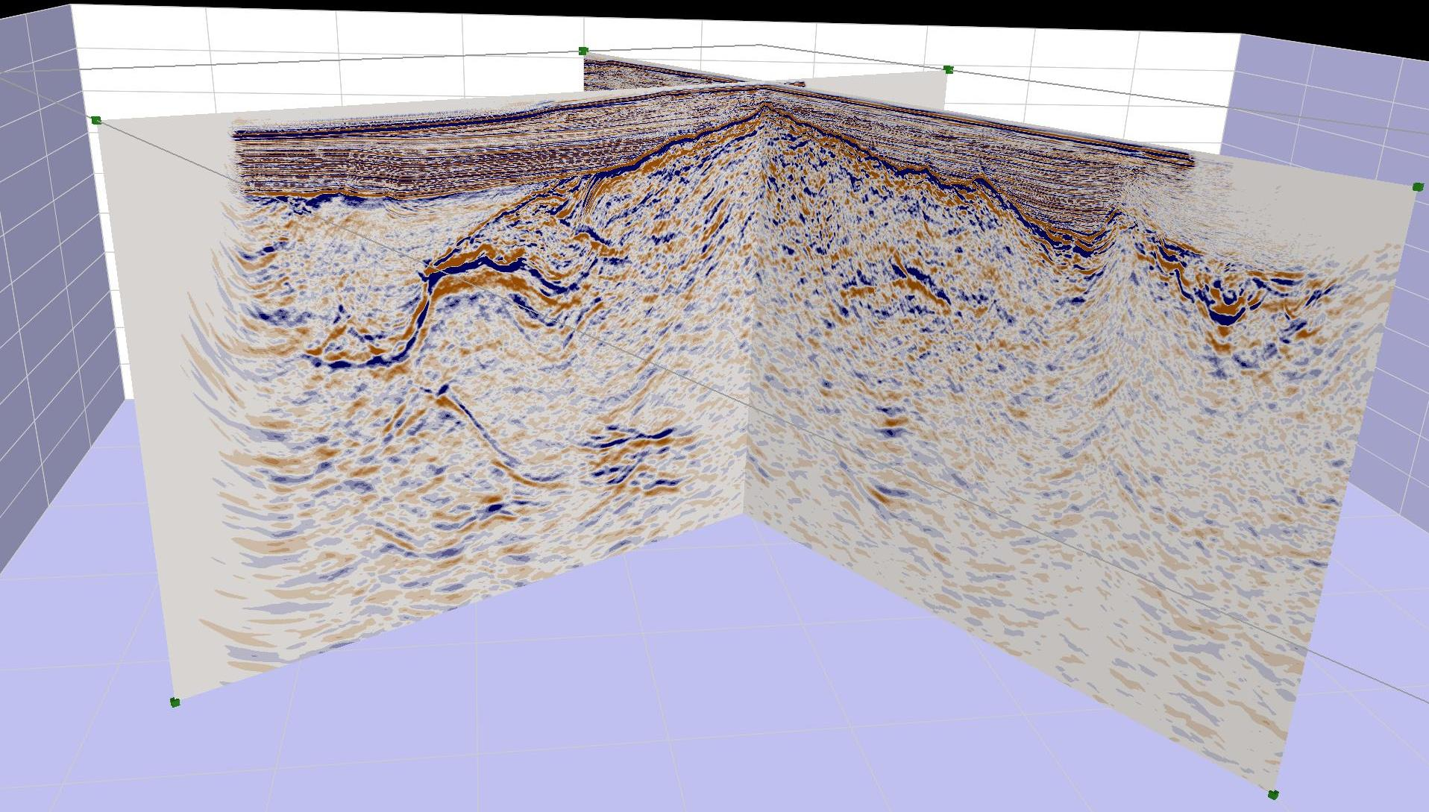
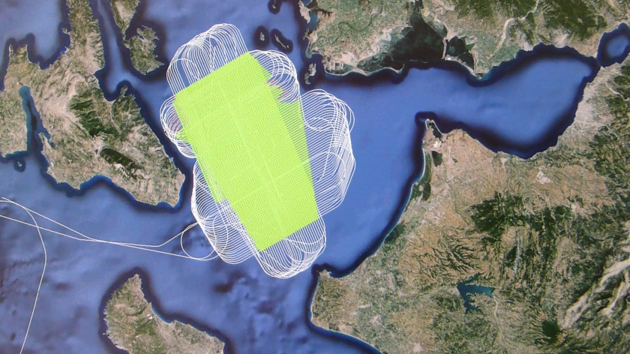

Slide 5
Η έρευνα πετρελαίου απαιτεί υψηλές επενδύσεις, σύγχρονη τεχνολογία, πολύ δουλειά με προσήλωση στο στόχο και στους νόμους, νηφαλιότητα υπομονή και επιμονή.
Εμείς όλοι στα ΕΛΠΕ είμαστε αισιόδοξοι ότι το τελικό αποτέλεσμα θα είναι απολύτως θετικό, δικαιώνοντας τις προσπάθειες και τις προσδοκίες τόσο του Ομίλου μας όσο και του Ελληνικού λαού.

Slide 6
Thank you for your attention

